Slide 1
Making powerpoint slidepacks in R
Richard Wilson

Slide 2
The Task
Integrated Care Partnership wanted an Outcome Framework to measure their impact
Result was 151 indicators over 7 domains at ICS, Place/Locality, Provider Collaborative and PCN
90 of the indicators are readily available via Fingertips
Need a way of visualising this
Powerpoint slidepacks are a go to solution for briefing meetings (disappointingly)

Slide 3
FingertipsR
Fingertips is one of the best organised open publication web resources
Supported by r packages
Fingertips
indicators() lists all the indicators
indicator_metadata() provides the detail from the definitions view
Indicator_areatypes() provides the areatypes for specified indicators
fingertips_data() pulls back all the data for specified indicators
Fingertipscharts (is it still maintained?)
Recreates the charts as seen on the website
API

Slide 4
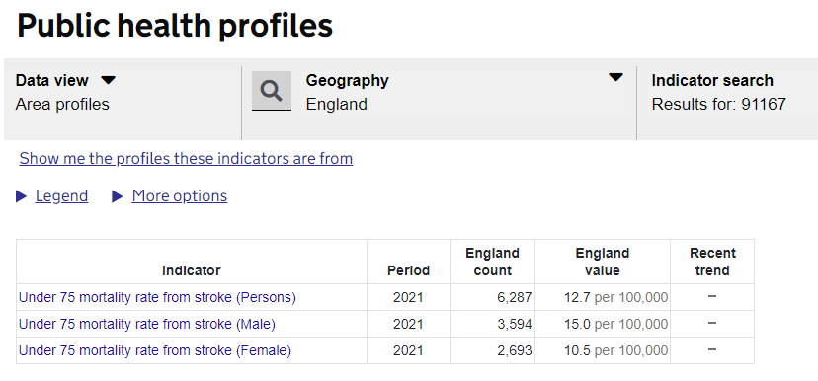
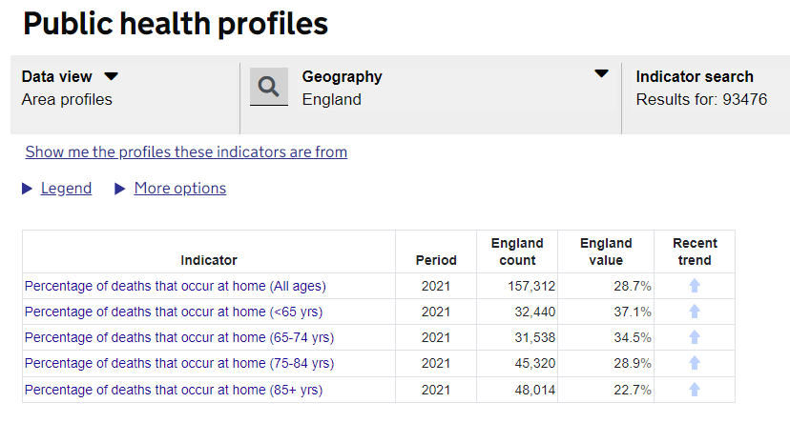
Fingers data
Is not tidy!
IndicatorIDs are not unique!
More than one gender specific category or age group

Slide 5
Also
Not all indicators are available for the latest geography
Some appropriately e.g. ICB for primary care
But other just not updated to latest counties and LA
Some only have one point
Some are missing denominator
Resolved by creating a new ID concatenating

Slide 6
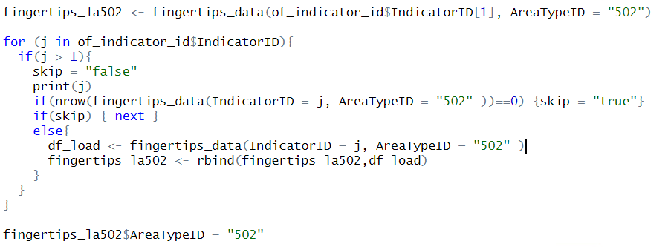
Downloading the data set
Loop through the list of indicators for every areatype you are interested in (I am sure there is an easier way but this works)

Slide 7
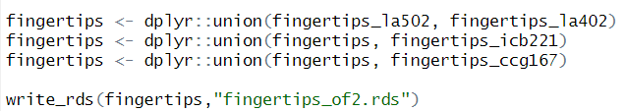
Downloading the data set
The different areatypes have one differing column name
If you download a single indicator for AreaTypeID = “All” this is not an issue
Then union them together

Slide 8
Markdown vs OfficeR
Choice was all about control and freedom to design
Markdown is a dark grey box that is difficult to align between your corporate slide master and its output
Difficult to accommodate bespoke layouts that are used in slide pack
Best suited to simple presentations
Good resource for building presentations is
https://jelsema.github.io/post-stats/looping-powerpoint-slides-in-rmarkdown/
OfficeR gives greater co-ordinate control over where place items.
You can create bespoke layouts in slide master for custom layouts you want.
Easier to set font styles in a consistent matter

Slide 9

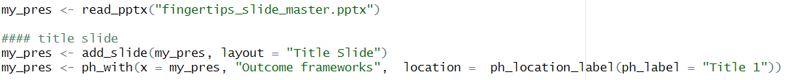
Creating the slidepack
In officer creating a slide is as easy as 1-2-3
Read in master power point
Add a slide with layout you want
Add content to the location in the layout

Slide 10
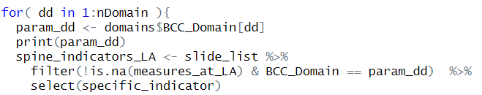
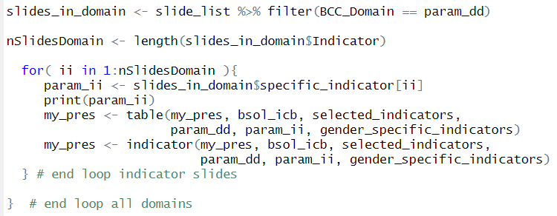
Creating slide pack
My structure is
7 domain chapters
Outliers worse than England
Outliers better than England
Spine chart
One for each area type
Rationale and summary table
Funnel plot and trend chart (where data permits)
Over 150 slides
Print slides

Slide 11
Charts
Replicate Fingertips spine charts using fingertipscharts
Use FunnelplotR for funnel plots

Slide 12
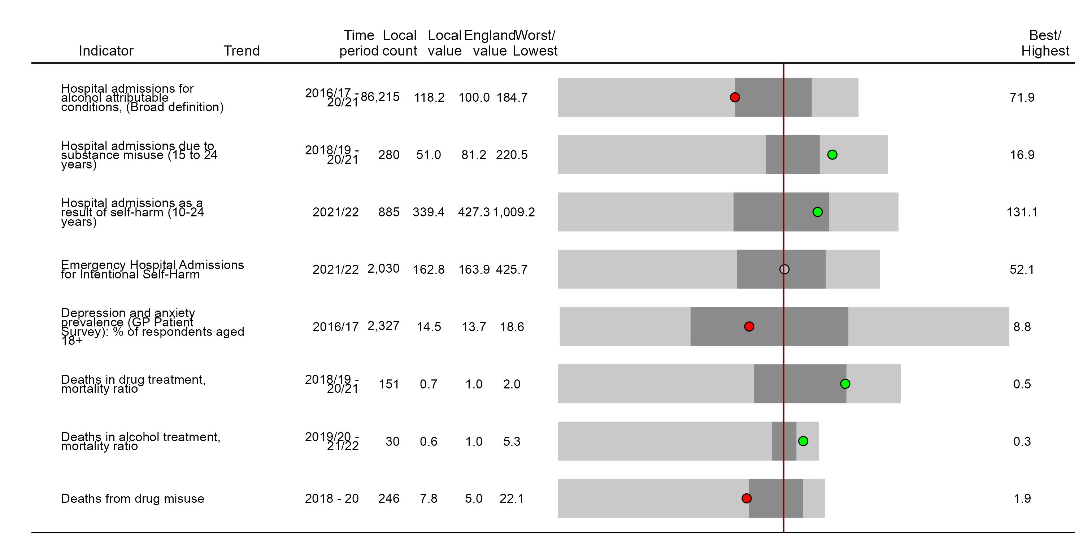
Mental health - Birmingham

Slide 13
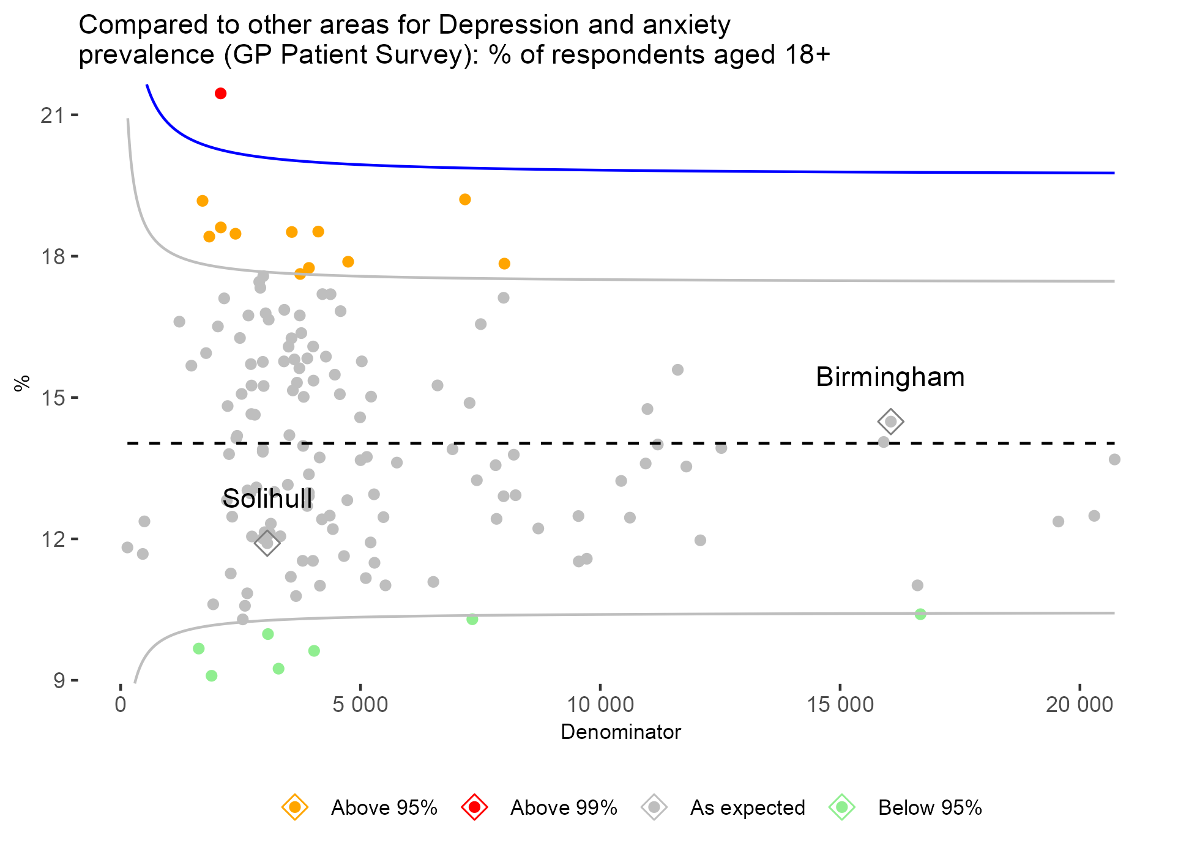
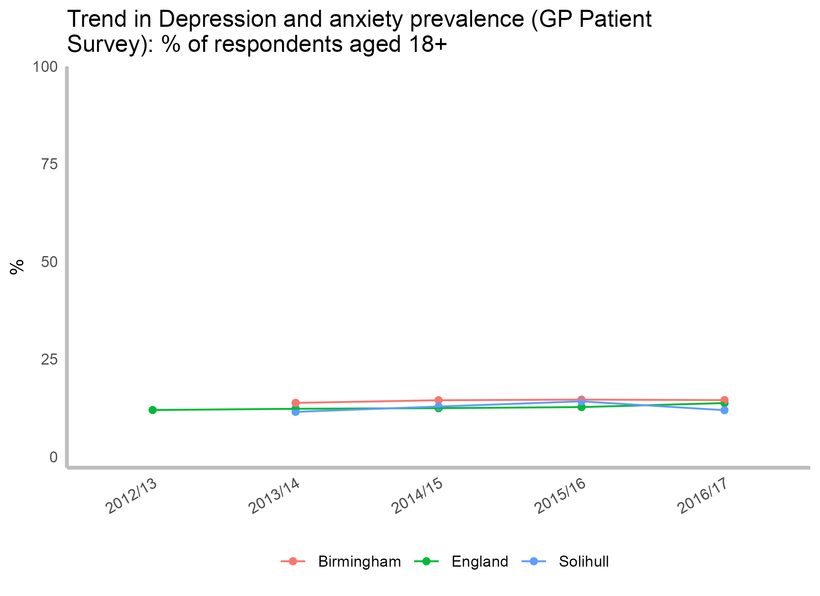
Depression and anxiety prevalence (GP Patient Survey): % of respondents aged 18+

Slide 14
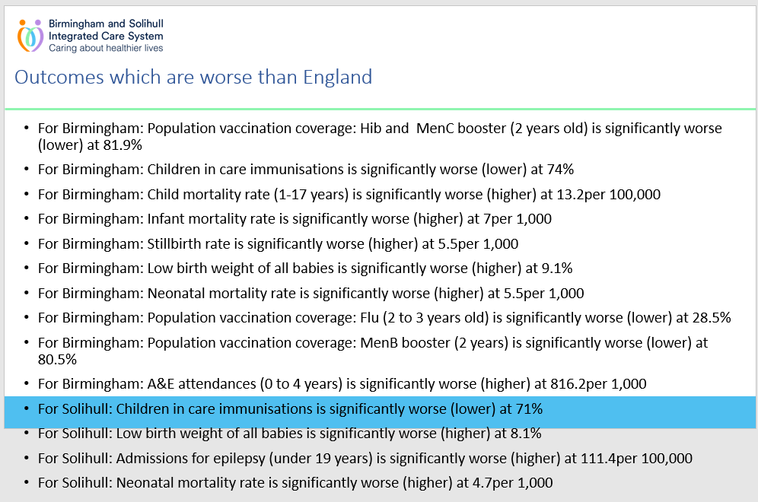
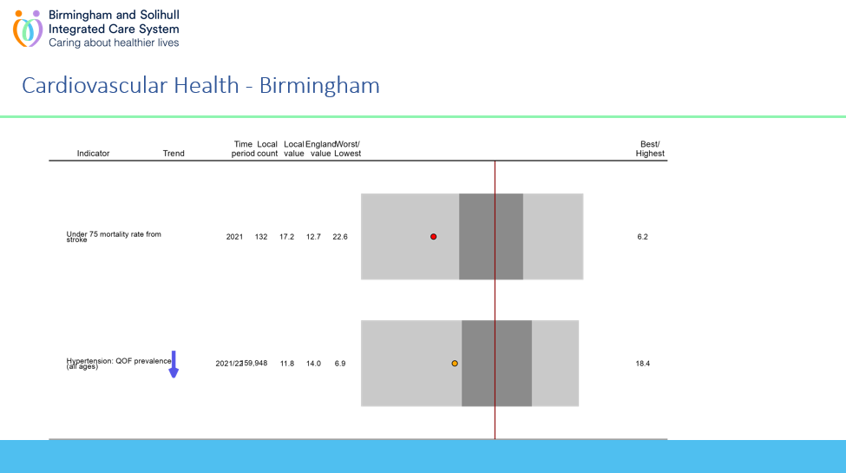
Issues
Too many indicators and varying in numbers in each domains means it is difficult to present create visually balanced slides

Slide 15
So…
OfficeR is very flexible
R is v efficient at producing VERY large slide packs
But any slide pack is going to benefit from a balanced indicator set otherwise generalised formatting is going to lead to compromises and sometimes manual fixing
Fingertips is not tidy and caution needs to be exercised if selecting from across multiple profiles.
Birmingham-and-Solihull-ICS/OutcomesFramework: Building the Outcomes Framework (github.com)

